Slide 1
git
Dagon University Department of Computer Studies
Group Number - 2
Supervised by - Dr. Daw Win Win Shwe
Presented by - Htet Myat Aung(Team Leader)
- Hein Htoo Aung
- Pyae Phyo Aung
- Aung Moe Kyaw

Slide 2

contents
Introduction
What is git?
Features of git
Potential of git
Pros and cons of git
Knowledge sharing from us
Conclusion
About us

Slide 3
what is git?
History of Git
Free and open source distributed version control system
What is GitHub
Git vs GitHub

Slide 4
history of git
Created by Linux Torvalds(father of Linux) and other developers contributing to develop Linux
Developed in 2005
Maintained by Junio Hamano(Japanese developer in Califonia working for Google)
latest updated in 21.6.2018

Slide 5

Developer of git
Linux Torvalds

Slide 6

Free and open source
Yes, Yes, I know totally free and Open Source at the same time

Slide 7

Git isn’t the only version control system
So why Git? Because most people think it is the best

Slide 8
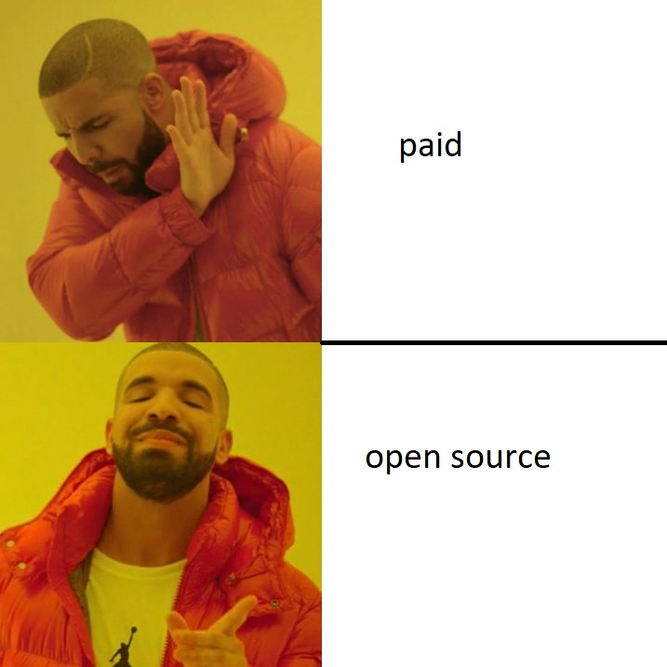

Slide 9
DISTRIBUTED VERSION CONTROL SYSTEM
Version Control?
Distributed?
Distributed vs Centralized

Slide 10
Phase 1
Phase 2
File_ver1
File_ver1
File_ver2
File_ver2
File_ver3
File_ver3
Base_ver3
Base_ver3
Base_ver3
Base_ver3
File_ver4
Phase 3
Phase 4
File_ver1
File_ver1
File_ver2
File_ver2
File_ver3
File_ver3
File_ver4
File_ver4
File_ver4
File_ver6
File_ver5
File_ver5
Why Version Control

Slide 12
Differences between git and github
Git
Version control system
Used the user’s personal computer hard drive space to do version controll
Github
Cloud base version control system based on git
Can use both the user’s personal computer hard drive space or cloud servers of github

Slide 13

GIT VS GITHUB
GIT
GITHUB
Logo
Backup on user’s computer
Logo
Backup on the GitHub server

Slide 14
features
Version control
Basic controls(branching,push,pull,commit,merge)
Public opensource feature
Having license paid extension for security for entreprise level development

Slide 15
Features of version control

Slide 16
Introduction to git
What is Git?
Features
Potential of Git
Pros and Cons

Slide 17
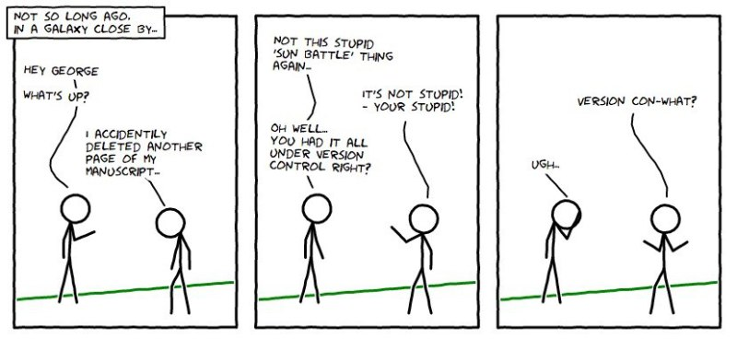
Accidental deletion of important data

Slide 18
potential
Advanced workspace environment
Carrier advancement and convenience CV
Work at home only
Git as necessary job requirement

Slide 19
Q & a
Any questions?

Slide 20
Thank you

Slide 21
Pros and cons
Pros
Cross platform compatibility
Advanced version control system with backup on server and all associated devices
Easy yet efficient to use
Able to use both in GUI or through command lines
Cons
Can cause conflicts in parallel development
Need to recheck because each commit is visible to all coworkers

